Slide 1
Exploratory Data Analysis of Bank Customer Churn Dataset
Submitted By: Your Name
Internship Name : DataXLabs Data Analyst Internship
Tools Used: Python, Pandas, Matplotlib, Seaborn

Slide 2
Objective: Extract insights using visual and statistical exploration.

Slide 3
Data Cleaning
Data Preprocessing Steps
Checked data types
Checked missing values
Checked duplicate records
Removed customer_id column

Slide 4
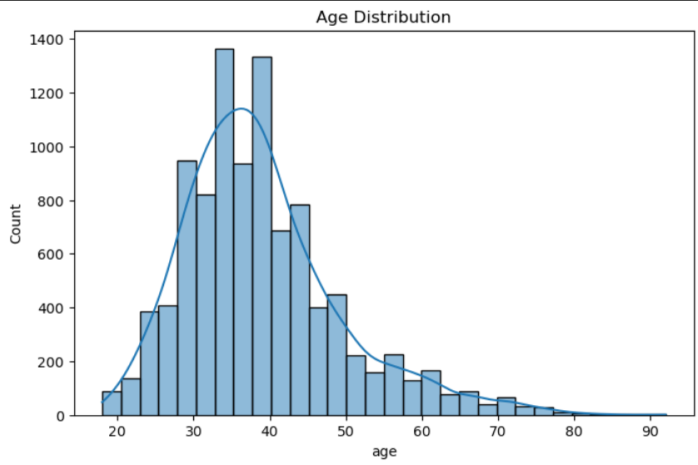
Age Distribution
Observation
Most customers belong to the age group 30–45 years.

Slide 5
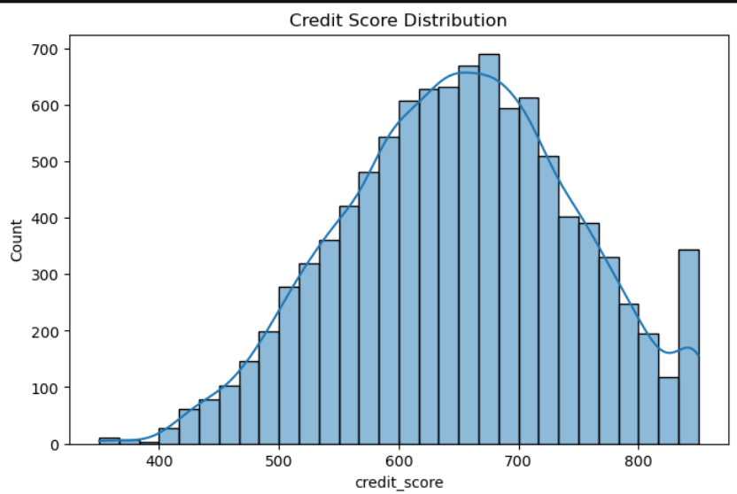
Credit Score Distribution
Observation
Credit scores are approximately normally distributed.

Slide 6
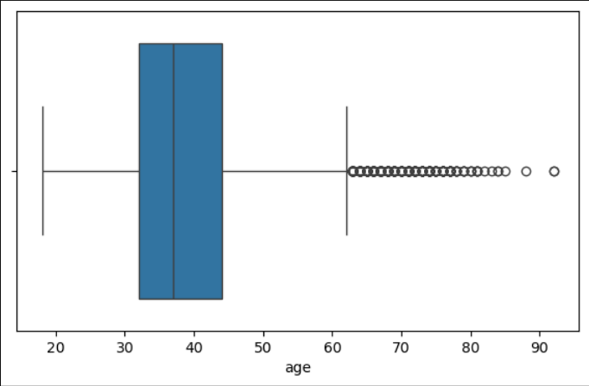
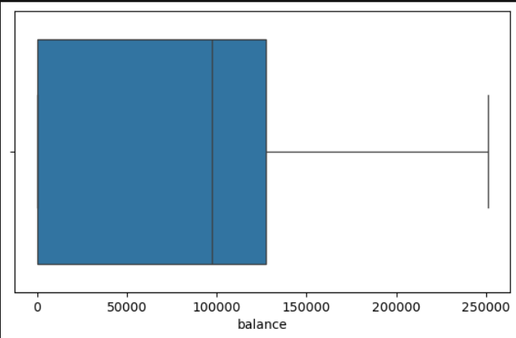
Boxplots
Observation
Age and balance contain some outliers.

Slide 7
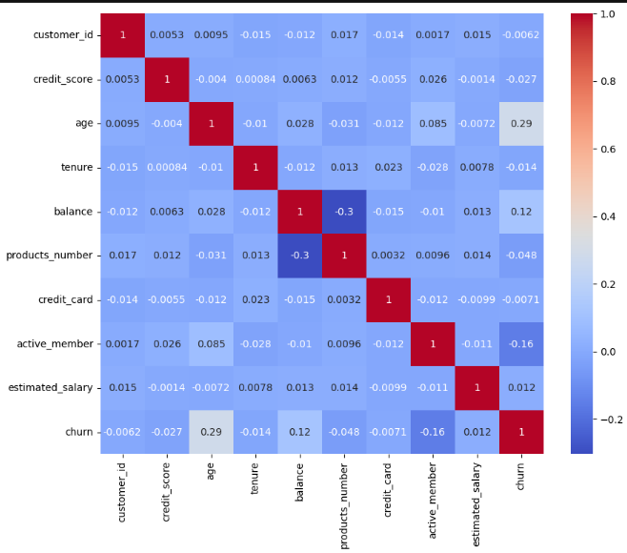
Correlation Analysis
Observations
Age is positively correlated with churn.
Active members are less likely to churn.
Credit score has weak correlation with churn.

Slide 8
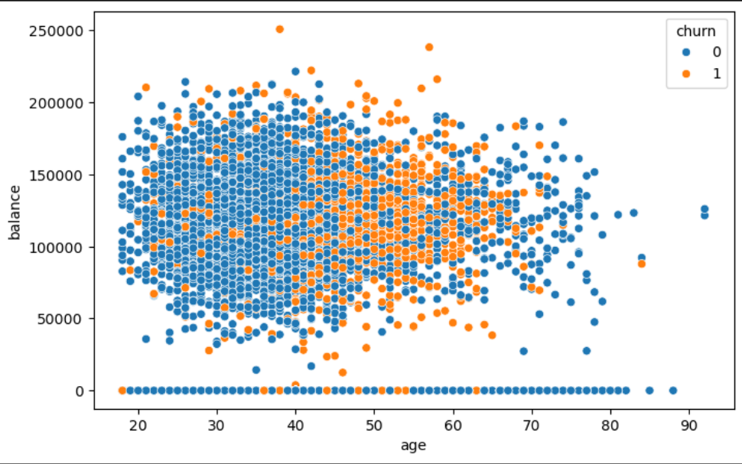
Scatter Plot Analysis
Observation
Customer age and balance show noticeable
variation among customers.

Slide 9
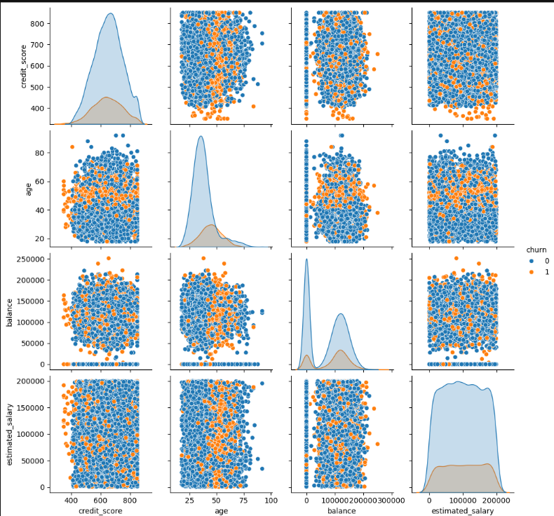
Pairplot Analysis
Observation
Age demonstrates noticeable separation
between churned and non-churned customers.

Slide 10
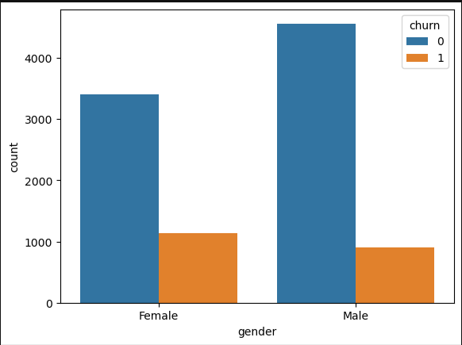
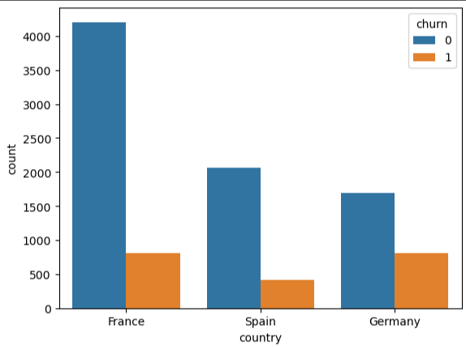
Relationships and Trends
Churn by Age
Churn by Country

Slide 11
Key Findings
Dataset contains 10,000 records and 11 useful features.
No missing values or duplicate records were found.
Majority of customers belong to France.
Most customers are aged between 30 and 45 years.
Age is positively correlated with churn.
Active members are less likely to leave the bank.
Germany exhibits relatively higher churn rates.
Credit score has weak correlation with churn.
Male and female customers are almost equally distributed.

Slide 12
Conclusion
The exploratory data analysis revealed that the dataset is clean and suitable for analysis. Age and customer activity show noticeable relationships with churn, while credit score has little association with customer attrition. Germany exhibits higher churn rates compared to France and Spain. These insights provide a foundation for further predictive modeling and customer retention strategies.

